Slide 1
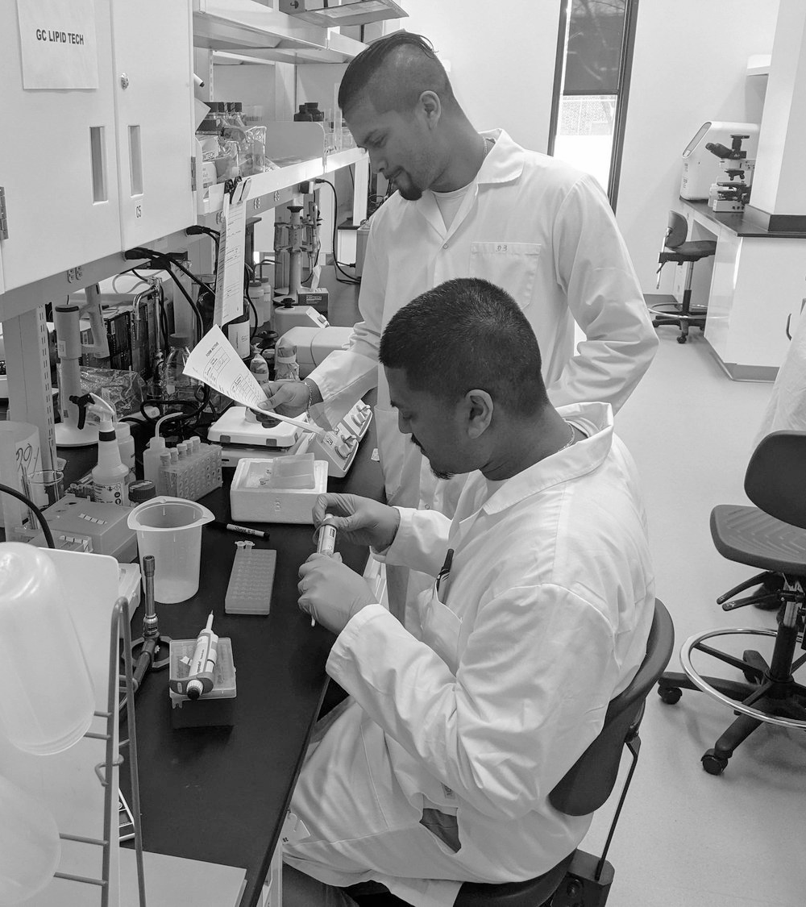
Application document for the
Scientific and Innovative Venture Program (SIVP)
Your startup name:
Candidate name:
January 2025

Slide 2
Table of contents
Section 1: Program overview, rules and instructions
Benefits of the SIVP | 3
Instructions to complete this document | 4
Important points to consider when determining eligibility | 5
Evaluation criteria | 6
Section 2: To be completed by the candidate
Project quality | 7
Project impact | 9
Project readiness level | 11
Anticipated benefits | 40
Bibliography | 44

Slide 3
Overview of the benefits for participants in the Scientific and Innovative Venture Program
Financial Support
Hosted at a Quebec university*
Connection to the ecosystem
A bursary of $50,000 per year, renewable for a second year, offered by the Fonds de recherche du Québec, will allow the candidate to fully devote their time to their business, their research and the program.
The candidate develops their startup and conducts their research at one of the participating universities across Quebec.*
We collaborate with incubators, university entrepreneurial centers and acceleration programs across Quebec and Canada to offer tailor-made support.
Personalized journey
Advisory council
And other benefits
Personalized support and access to workshops to guide the development of the business and personal skills. We will help candidates stay on track to achieve their goals.
We build an advisory council to help propel the startup onto the market. The advisory council will be made up of experts adapted to the needs of the startup.
Networking activities, marketing and branding resources, public speaking training, as well as in-kind benefits from our partners.
3
* All universities in Quebec are eligible. The steps will be taken for the first time in several university settings.

Slide 4
Instructions for completing this document
Make sure you read the SIVP Program Rules
Only one candidate per company is allowed to apply.
For text, please use Arial, font size 10 minimum.
Make sure your responses are concise and easy to understand. Apart from the pages relating to the technological or societal solution and intellectual property, avoid technical jargon.
Feel free to use images to illustrate your points, as they can sometimes speak louder than words. Note that they count towards the total number of slides allowed.
Only disclose necessary information. Please note that this information will be shared with the 4 partners of the program and with the evaluation committee but will remain confidential.
Keep the structure of this presentation with a white background. You will not receive points for design elements.
Use the last page for your bibliography.
WARNING - Do not exceed the number of slides allowed, as excess slides will not be included when uploaded.
4

Slide 5
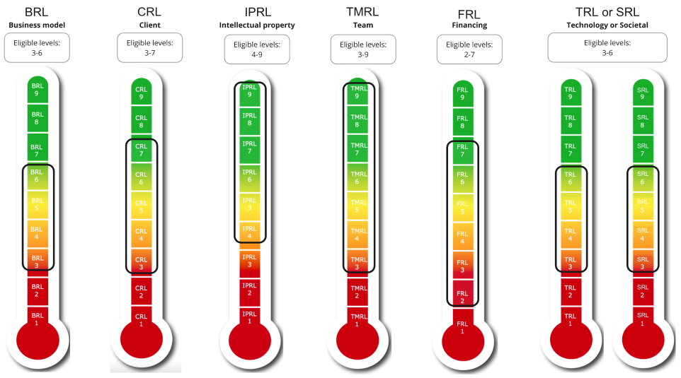
In order to maximise the benefits to startups, a minimum level of maturity must have been reached to be eligible for the SIVP. If the startup is too advanced to benefit from the financial and non-financial aspects, the startup will be considered ineligible for the programme. For example, for the CRL, the startup must have reached at least level 3 and no more than level 7.
The eligibility of applications will be determined by your startup's position on the six "Innovation readiness levels" (IRL). For each level, the startup must fall within the predetermined slot indicated below. If your startup does not meet each of the required levels, you will not be eligible for the SIVP.
The set of questions to be answered to demonstrate your startup's positioning on the scales is specified for each scale later in this application document.
Eligible Readiness Levels
Important points to consider for the eligibility of your application

Slide 6
Quality of the entrepreneurial project (20%)
Clarity of the description of the problem to be solved
Clarity and relevance of the entrepreneurial solution proposed to resolve the problem
Innovativeness
Impact of the project (societal, economic, environmental) (20%)
Local, national, international
Proof that the level of progress of the project and the team is in accordance with the profile targeted by the program (40%)
Readiness level on the 6 innovation readiness levels with concrete examples to support the selected level
Anticipated benefits of participation in SIVP (20%)
Potential impact of SIVP funding and support
For the candidate
For business creation
For the development of the entrepreneurial solution in line with the action plan provided in the application
Motivation and integration of entrepreneurship into the applicant's career plan
Demonstration of the need for a host university
Evaluation criteria

Slide 7
Project quality

Slide 8
Describe the problem to be solved and why it is important. What will be the impact if the problem persists? Describe the solution to be developed, its innovative nature and its relevance to the entrepreneurial solution. Use Arial size 10 minimum. (Maximum 1 slide)
Type your answer here…
Quality of the entrepreneurial project (maximum 1 slide)

Slide 9
Project impact

Slide 10
Describe how the project has a potential impact on society, the economy and the environment in Quebec. Describe how this impact could also extend to the rest of Canada and internationally. Please use at least Arial font size 10 for the text.
Type your answer here...
Project impact (maximum 1 slide)

Slide 11
Project readiness level

Slide 12
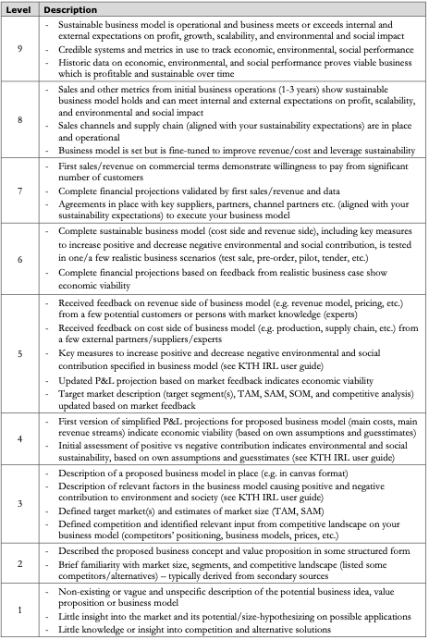
Indicate which Level your startup has COMPLETELY achieved and why
Check that you have satisfied all the points mentioned in the description
If you have not achieved all the elements of the Level, please default to the lower level
Be sure to address each dash for the level achieved and support your answers with concrete evidence that you have indeed achieved that level in your journey
If you have achieved some of the points listed at higher levels, please mention them. (Maximum 1 slide)
Note: You must have conducted more than 40 interviews with various stakeholders in several potential market segments to qualify for SIVP.
Business Model Readiness Level - BRL

Slide 13
Type your answer here…
Business Model Readiness Level - BRL (maximum 1 slide)

Slide 14
Please use the following three slides to answer the questions below which will help us to understand and gain an insight into your business model. Present your customer segmentation and value proposition. Please indicate whether this information has been validated and how.
Who are your paying customers (current or future) or potential sources of revenue?
What do you think your value proposition is for these customers? And for your users (if the segment is different)?
Describe your sustainable competitive advantage / your "secret recipe" / the innovation that enables you to position yourself uniquely in the market compared to the competition. (Please do not disclose any confidential information)
Is it a physical product, a digital platform, a service, etc.?
What is the customer currently doing to solve the problem? List the alternatives. Who are the other players (and competitors)?
Describe the market validation (particularly interviews) carried out to date. What have you validated and invalidated? How many validation interviews were carried out? How long did the validation interviews last? How many customer segments did you consider?
How do you intend to make money from your product or service (what is your revenue model)?
What are your main costs in providing the product or service to your customers?
What price can you charge for your product or service?
Follow-up questions: Business Model - Customers and value proposition (maximum 3 slides)

Slide 15
Type your answer here…
Business Model - Customers and value proposition (1 of 3)

Slide 16
Type your answer here…
Business Model - Customers and value proposition (2 of 3)

Slide 17
Type your answer here…
Business Model - Customers and value proposition (3 of 3)

Slide 18
Please use the following two slides to answer the questions below, which will help us to understand and gain an insight into your business model.
What is the size of the target market, annual market growth, market trends?
How much of this market can you capture? What is the Total Available Market (TAM), the Serviceable Available Market (SAM), and the Serviceable Obtainable Market (SOM)?
How will you win market share? Outline your high-level go-to-market strategy.
How do you plan to build relationships with your customers?
Tell us about the traction you've seen in the market. Do you have any listings for your product? Positive customer feedback? Letters of support? Industrial partners?
What would be the 2 or 3 follow-up markets?
Business Model - Market opportunity (maximum 2 slides)

Slide 19
Type your answer here…
Business Model - Market opportunity (1 of 2)

Slide 20
Type your answer here…
Business Model - Market opportunity (2 of 2)

Slide 21
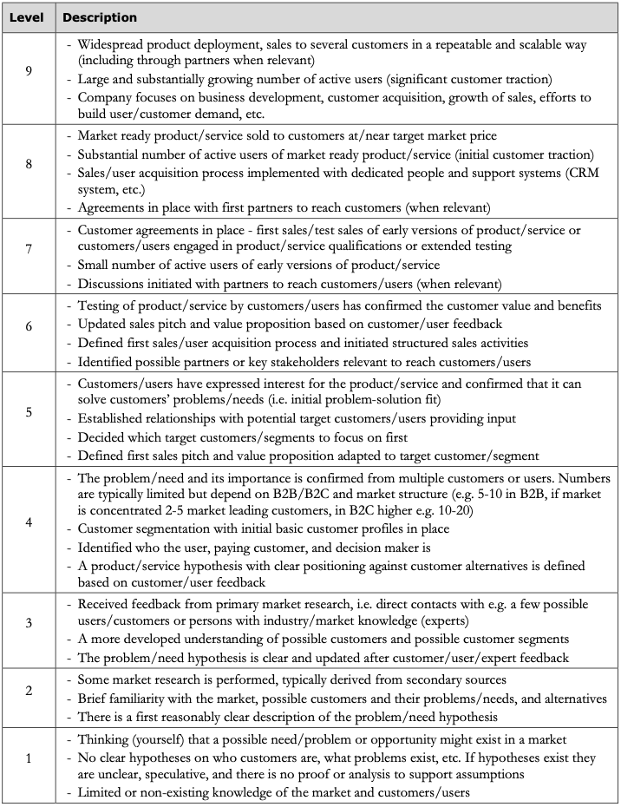
Indicate which Level your startup has COMPLETELY achieved and why
Check that you have satisfied all the points mentioned in the description
If you have not achieved all the elements of the Level, please default to the lower level
Be sure to address each dash for the level achieved and support your answers with concrete evidence that you have indeed achieved that level in your journey
If you have achieved some of the points listed at higher levels, please mention them. (Maximum 1 slide)
Customer Readiness Level - CRL

Slide 22
Type your answer here…
Customer Readiness Level - CRL (maximum 1 slide)

Slide 23
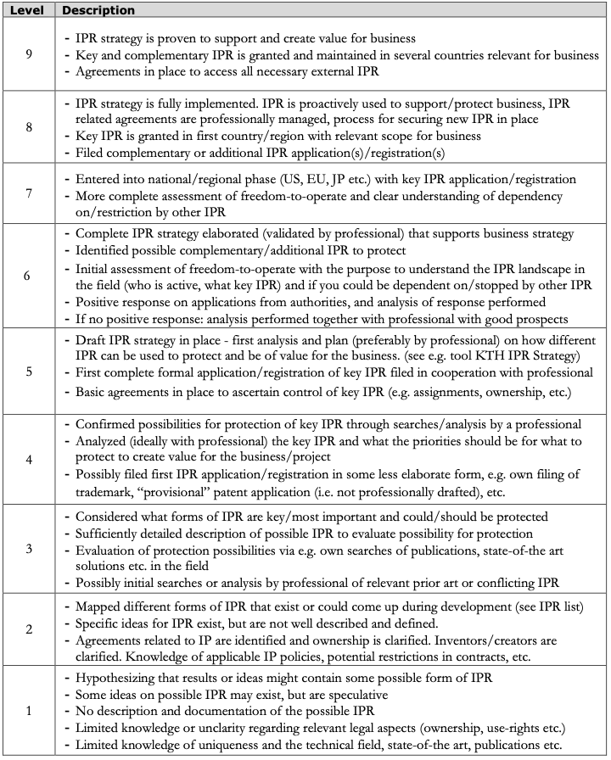
Indicate which Level your startup has COMPLETELY achieved and why
Check that you have satisfied all the points mentioned in the description
If you have not achieved all the elements of the Level, please default to the lower level
Be sure to address each dash for the level achieved and support your answers with concrete evidence that you have indeed achieved that level in your journey
If you have achieved some of the points listed at higher levels, please mention them. (Maximum 1 slide)
Intellectual Property Rights Readiness Level - IPRL

Slide 24
Type your answer here…
Intellectual Property Rights Readiness Level - IPRL (maximum 1 slide)

Slide 25
If the IP you intend to exploit comes from public research :
From which institution does the IP originate? Has this IP been declared to your establishment?
Who was involved in the development of this IP?
Does your company own the right to use this IP? Are you currently negotiating such a right of use?
If applicable, please indicate the reference number assigned by the technology transfer company in connection with the IP to be exploited by your company (Axelys, TransferTech, etc.).
If the IP you intend to exploit does not originate from public research :
Who participated in the development of this IP? Who owns the rights?
Does your company have the rights to use this IP?
Follow-up questions: Intellectual property rights for your startup (maximum 1 slide)

Slide 26
Type your answer here…
Follow-up questions: Intellectual property rights for your startup (maximum 1 slide)

Slide 27
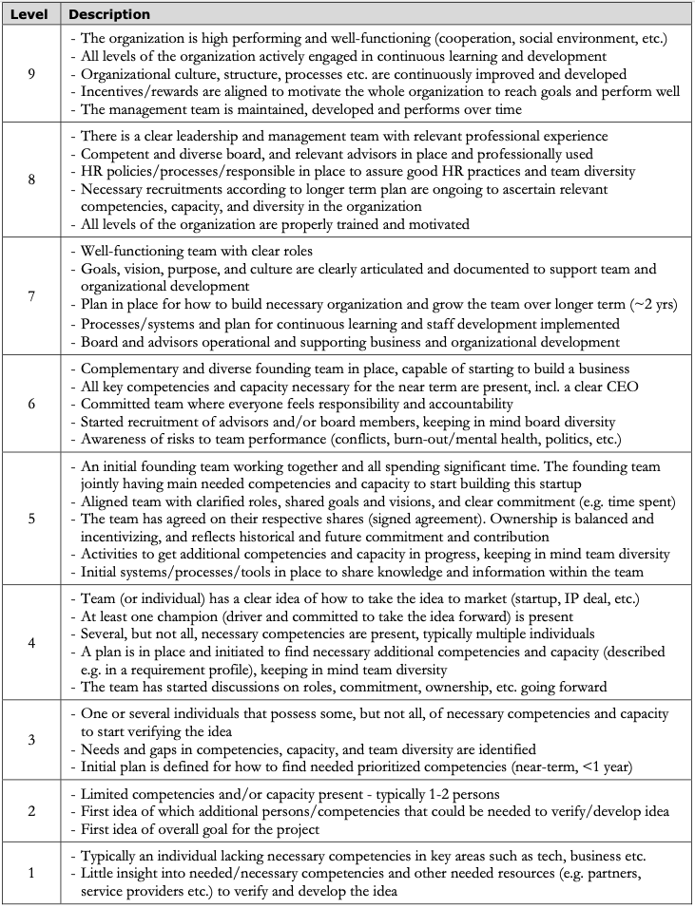
Indicate which Level your startup has COMPLETELY achieved and why
Check that you have satisfied all the points mentioned in the description
If you have not achieved all the elements of the Level, please default to the lower level
Be sure to address each dash for the level achieved and support your answers with concrete evidence that you have indeed achieved that level in your journey
If you have achieved some of the points listed at higher levels, please mention them. (Maximum 1 slide)
Team Readiness Level - TMRL

Slide 28
Type your answer here…
Team Readiness Level - TMRL (maximum 1 slide)

Slide 29
Please use the following slides to answer the questions below to help us get to know the team better.
Describe the support you received and the entrepreneurial training you completed (name them) in order to set up your startup.
Describe the team behind the entrepreneurial project: do you have co-founders, mentors, and/or a board of directors?
Do you have a shareholders' agreement? What is the equity split?
What is your vision for the team over the next two years? Who are the key members of your startup's team? Are you open to additional co-founders?
What is your current role in the team? How do you see your role evolving over time as the company grows?
Can you tell us about your current relationship with your supervisor in relation to the project? How are they specifically involved in the project (overall contribution, hours per week, other)?
Follow-up questions: Team (maximum 2 slides)

Slide 30
Type your answer here…
Follow-up questions: Team (1 of 2)

Slide 31
Type your answer here…
Follow-up questions: Team (2 of 2)

Slide 32
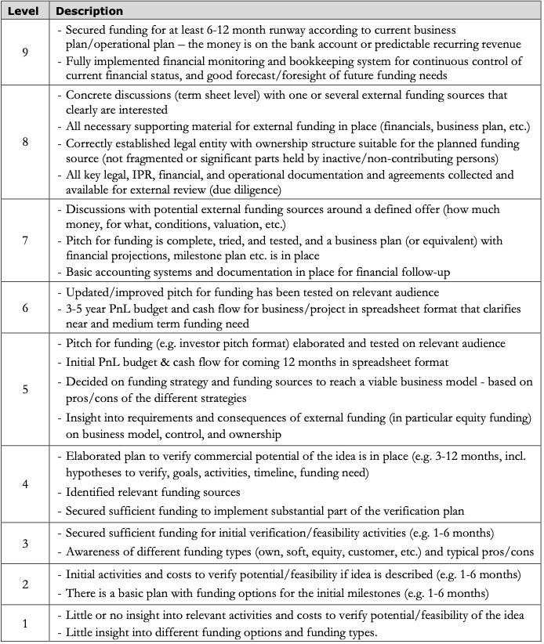
Indicate which Level your startup has COMPLETELY achieved and why
Check that you have satisfied all the points mentioned in the description
If you have not achieved all the elements of the Level, please default to the lower level
Be sure to address each dash for the level achieved and support your answers with concrete evidence that you have indeed achieved that level in your journey
If you have achieved some of the points listed at higher levels, please mention them. (Maximum 1 slide)
Funding Readiness Level - FRL

Slide 33
Type your answer here…
Funding Readiness Level - FRL (maximum 1 slide)

Slide 34
Total funding raised to date from all sources dilutive and non-dilutive?
With the cash currently in the startup, how many months of runway do you have?
What is your envisaged funding trajectory for the next 2-5 years? In other words, what are the major milestones to be completed and how much funding would you need for this?
Type your answer here…
Follow-up questions: Funding (maximum 1 slide)

Slide 35
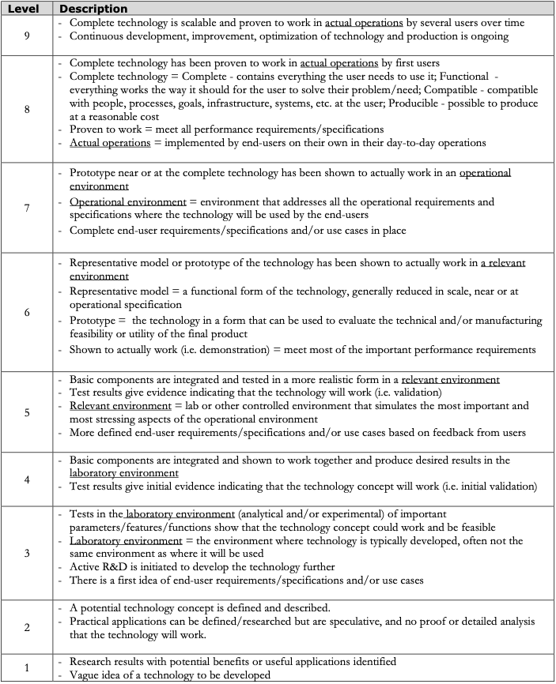
Indicate which Level your startup has COMPLETELY achieved and why
Check that you have satisfied all the points mentioned in the description
If you have not achieved all the elements of the Level, please default to the lower level
Be sure to address each dash for the level achieved and support your answers with concrete evidence that you have indeed achieved that level in your journey
If you have achieved some of the points listed at higher levels, please mention them. (Maximum 1 slide)
Technology Readiness Level - TRL

Slide 36
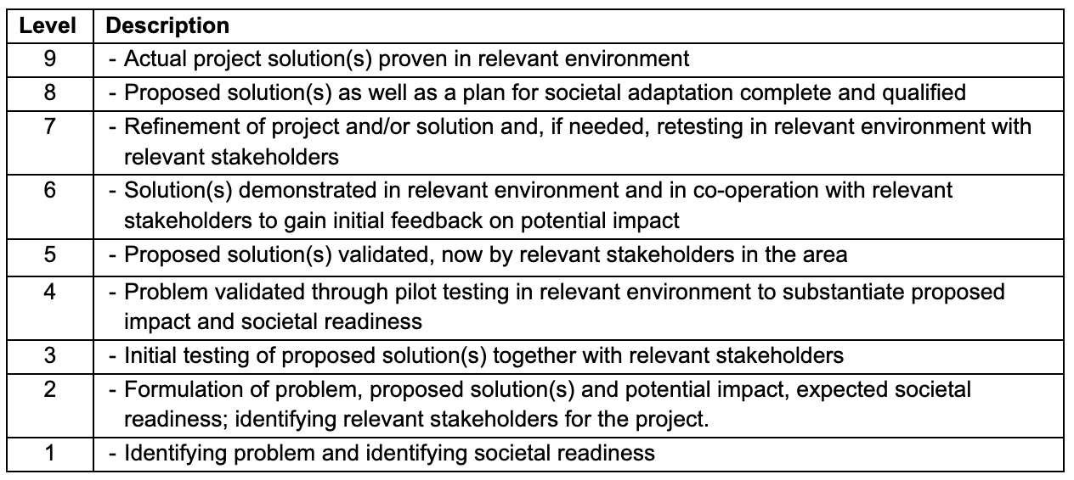
Indicate which Level your startup has COMPLETELY achieved and why
Check that you have satisfied all the points mentioned in the description
If you have not achieved all the elements of the Level, please default to the lower level
Be sure to address each dash for the level achieved and support your answers with concrete evidence that you have indeed achieved that level in your journey
If you have achieved some of the points listed at higher levels, please mention them. (Maximum 1 slide)
Societal Readiness Level - SRL

Slide 37
Type your answer here…
Technology Readiness Level or Societal Readiness Level - TRL OR SRL (maximum 1 slide)

Slide 38
Please use the following slide to answer the questions below:
Current status of the technology, product or service. Who was involved in the development? How long did it take to get to where it is now? If you have a physical or digital prototype, please include a photo.
What major commercial and technological milestones (if any) do you expect to achieve over the next 24 months? These are assumptions, of course, and will probably change.
If so, what regulations are needed to bring the product to market and align it with milestones?
Follow-up questions: Technological or societal solution (maximum 1 slide)

Slide 39
Type your answer here…
Follow-up questions: Technological or societal solution (maximum 1 slide)

Slide 40
Anticipated benefits

Slide 41
Please use this slide to answer the following questions:
What is the potential impact of SIVP financing and coaching for you, your company, and for the startup's evolution?
How would access to a $50,000 grant help you? Without SIVP funding, can the project continue to progress?
Do you currently have a full-time or part-time job?
Type your answer here…
Potential impact of SIVP financing and support (maximum 1 slide)

Slide 42
Explain why you have chosen to apply to the SIVP programme? Give concrete examples of how your entrepreneurial spirit has enabled you to take on the challenges you have encountered. What are the anticipated benefits of your participation in the programme?
Type your answer here…
Motivation to join the program (maximum 1 slide)

Slide 43
A host institution can have a significant impact on access to equipment, resources, and the speed at which your startup progresses. Please answer the following questions:
Do you need a host university to take the project forward? Explain why.
Have you identified a potential host university? Why do you want to be hosted at this particular university?
Have you identified a potential supervisor? Have you contacted them about this programme?* Do you already have a relationship with this person? Would you like to share any other information about the host institution?
Type your answer here…
The need for a host university to create or develop a company (maximum 1 slide)

Slide 44
Bibliography

Slide 45
List your references here…
References: bibliography and sources of information

