Slide 1
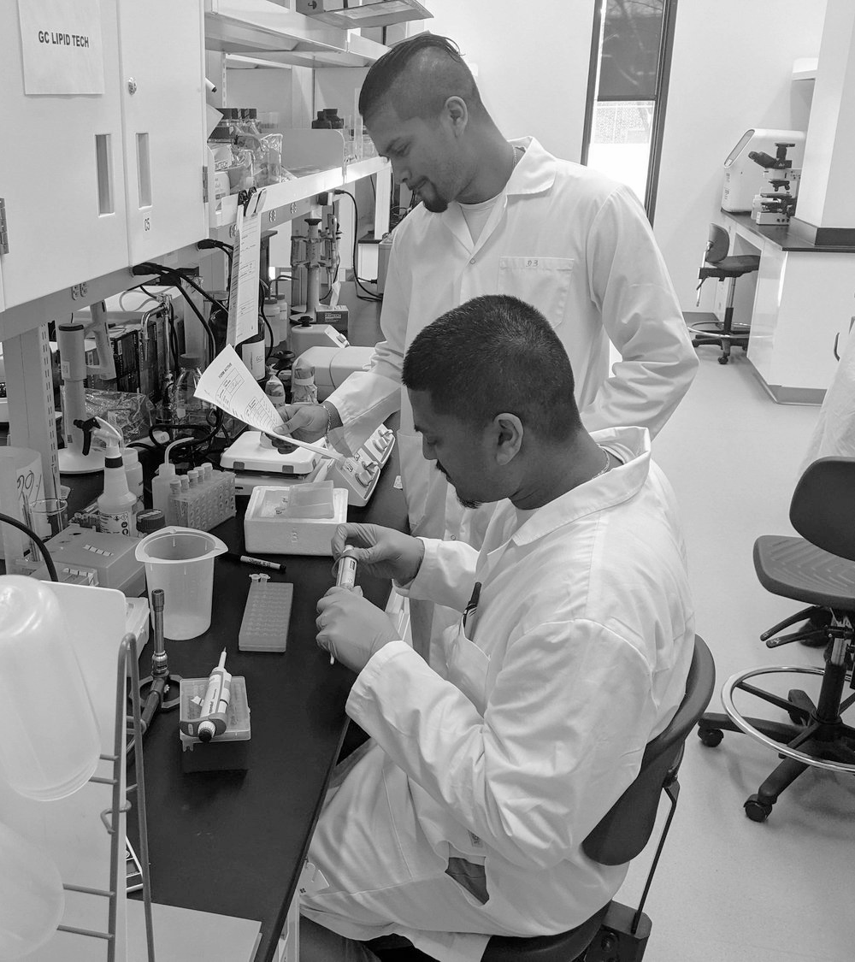

Application to
Programme de création d'entreprise scientifique et innovante (CESI)
Name of your startup:
Name of applicant:
Last update : December 2025

Slide 2
TABLE OF CONTENTS
Section 1: Program overview, rules and instructions
Instruction for completing this document | 3
Important points related to eligibility | 4
Evaluation criteria | 5
Section 2: To be completed by the applicant
Project quality and development stage | 6
Project impact | 31
Anticipated benefits | 33
Bibliography | 37

Slide 3
Instructions for completing this document
Make sure you read the CESI program rules.
Only one applicant per company is allowed to apply.
For text, please use Arial, font size 10 minimum.
Make sure your responses are concise and easy to understand. Apart from the pages relating to the technological or societal solution and intellectual property, avoid technical jargon.
Feel free to use images to illustrate your points, as they can sometimes speak louder than words. Note that they count towards the total number of slides allowed.
Only disclose necessary information. Please note that this information will be shared with the 4 partners of the CESI program and with the evaluation committee but will remain confidential.
Keep the structure of this presentation with a white background. You will not receive points for design elements.
Use the last page for your bibliography. Be sure to back up your project with science by listing key publications that support the information provided in your presentation.
WARNING - Do not exceed the number of slides allowed, as excess slides will not be included when uploaded.

Slide 4
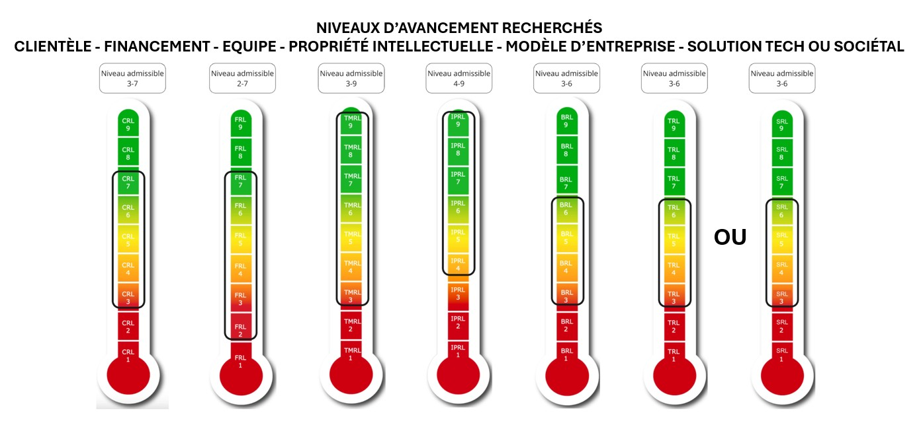
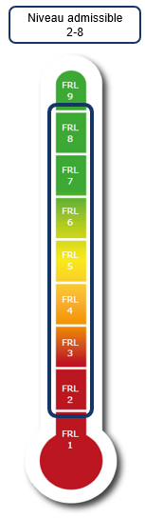
In order to maximize the benefits to startups, a minimum level of maturity must have been reached to be eligible for the CESI program. On the other hand, if the startup is too advanced, it will not be able to take full advantage of the financial and non-financial aspects of the program. Eligibility reflects this observation.
The eligibility of applications will be determined by the startup’s position on the six KTH Innovation Readiness Level scales. For each scale, the startup must fall within the predetermined range indicated below. If your startup does not meet each of the required levels, you will not be eligible for the award. For example, for the CRL (Customer Readiness Level), the startup must have reached at least level 3 and no more than level 7 to be eligible.
The set of questions to be answered to demonstrate your startup's position is specified for each scale in the appropriate section of this presentation document.
Important points to consider for the eligibility of your application

Slide 5
Evaluation criteria
1. Quality of the entrepreneurial project (40%) (with consideration for innovation readiness levels)
    Clarity and relevance of the problem to be solved and the solution proposed.
    The startup stands out significantly from the competition, and its marketing strategy and business model demonstrate a coherent and promising vision.
    The startup has an intellectual property strategy that has the potential to support its marketing strategy.
    The founding team demonstrates strong entrepreneurial potential, appears dedicated, and includes the right people to reach the next inflection point.
    The technological challenges/uncertainties associated with the project are well identified and addressable.
    Demonstration of the realism of the entrepreneurial approach and potential for success in relation to the startup’s sector of activity.
2. Impact of the project (social, economic, environmental) (30%)
The startup is aware of its negative externalities and is taking action to minimize them.
The startup demonstrates a positive social, environmental, or economic contribution.
3. Anticipated benefits of participation in the CESI program (30%)
Potential impact of CESI funding and support
  For the applicant
  For the startup
Demonstration of the need for linkage with a university.

Slide 6
Project quality and development stage

Slide 7
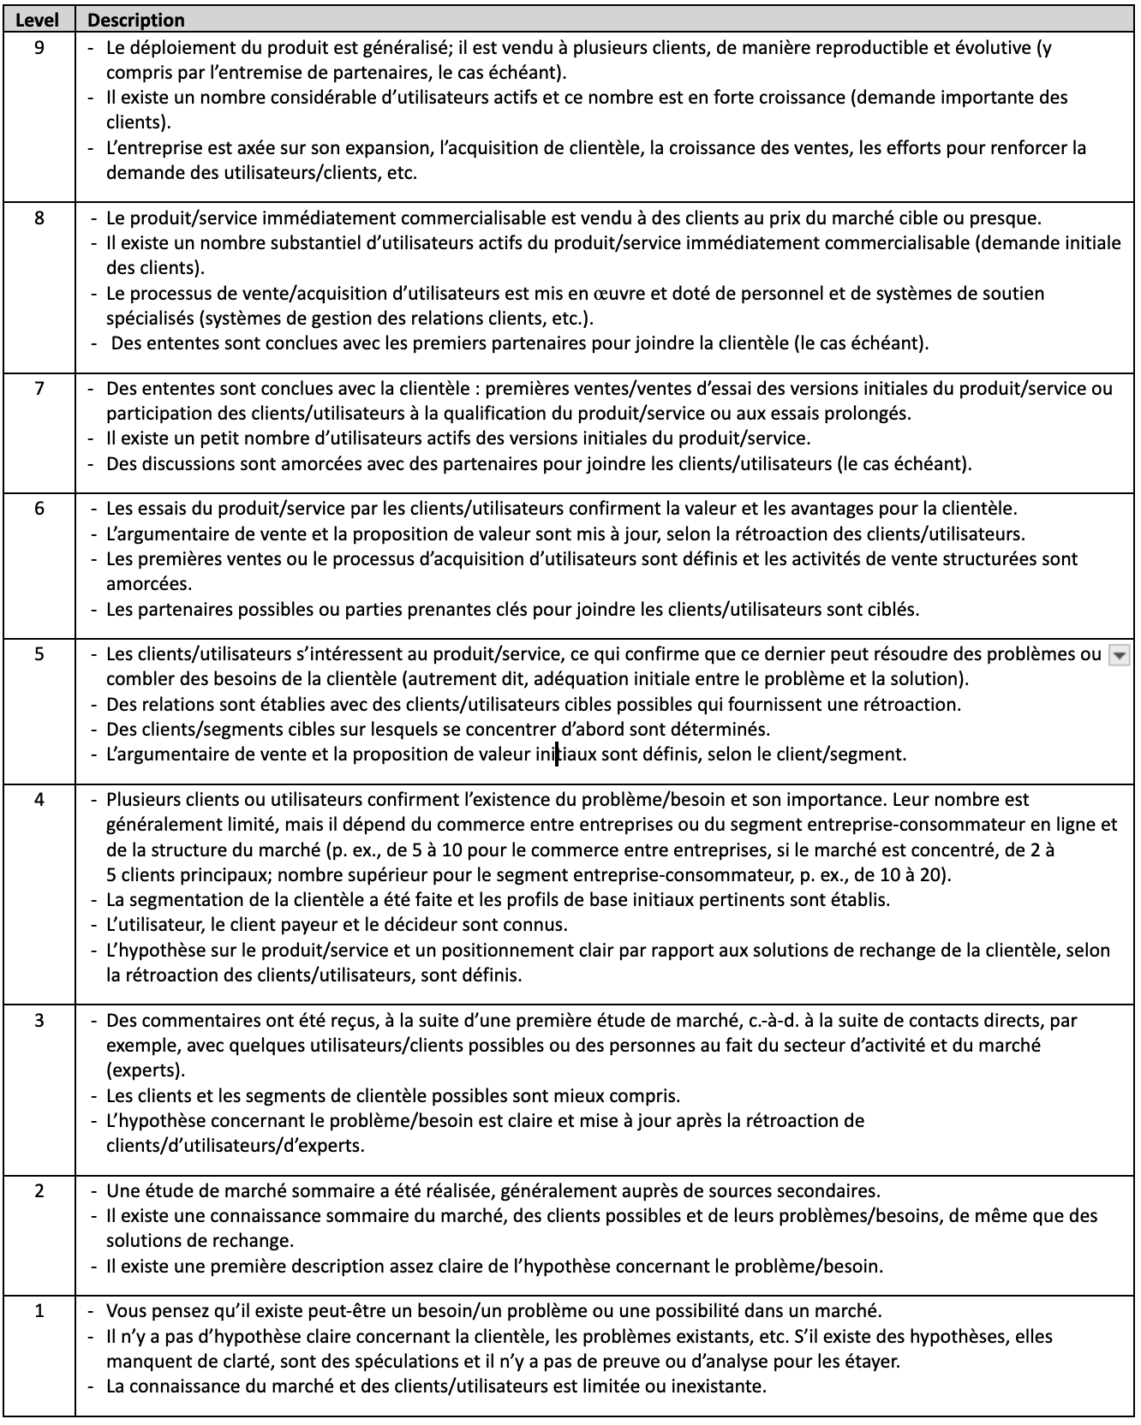
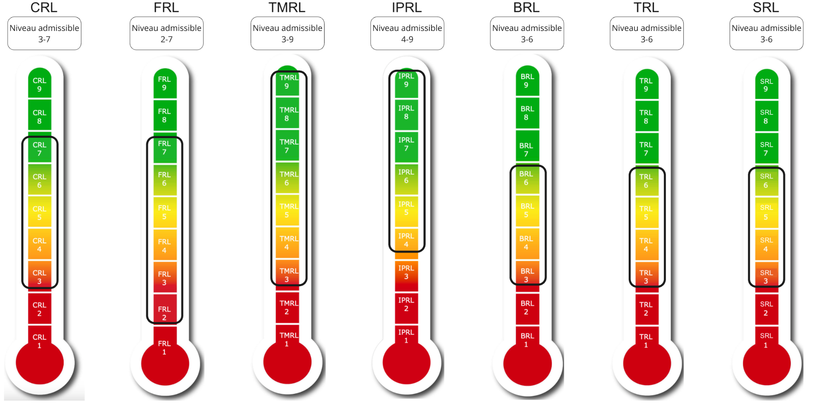
- Indicate which level your startup has COMPLETELY achieved and why;
- Check that you have satisfied all the points mentioned in the description. If you have not achieved all the elements of the level, please default to the lower level;
- Be sure to address each bullet point for the level achieved and support your answers with concrete evidence that you have indeed achieved that level in your journey;
- If you have achieved some of the points listed at higher levels, please mention them.
To be eligible for the CESI program, you must have conducted more than 40 interviews with various stakeholders in several potential market segments (please refer to the program rules for the definition of “interview” under the program).
Customer Readiness Level - CRL

Slide 8
CUSTOMER READINESS LEVEL – CRL (maximum 2 slides)
What CRL level has been achieved? Type your answer here
How many interviews were conducted? Type your answer here
Describe the problem to be solved and why it is important. Reminder: feel free to support your answer using the bibliography to be included at the end of the document.
Type your answer here
How was this problem expressed to you in the customer interviews? What have you validated and invalidated? How did you structure your validation interviews (individual interviews, group interviews, surveys, discussions with KOLs, etc.)? How many customer segments did you consider?
Type your answer here

Slide 9
CUSTOMER READINESS LEVEL – CRL (maximum 2 slides)
Describe your value proposition for this problem. How was this expressed to you in the customer interviews? What have you validated and invalidated?
Type your answer here
Who are your customers? Describe them, explaining the difference (if relevant) between users, paying customers and decision-makers.
Type your answer here

Slide 10
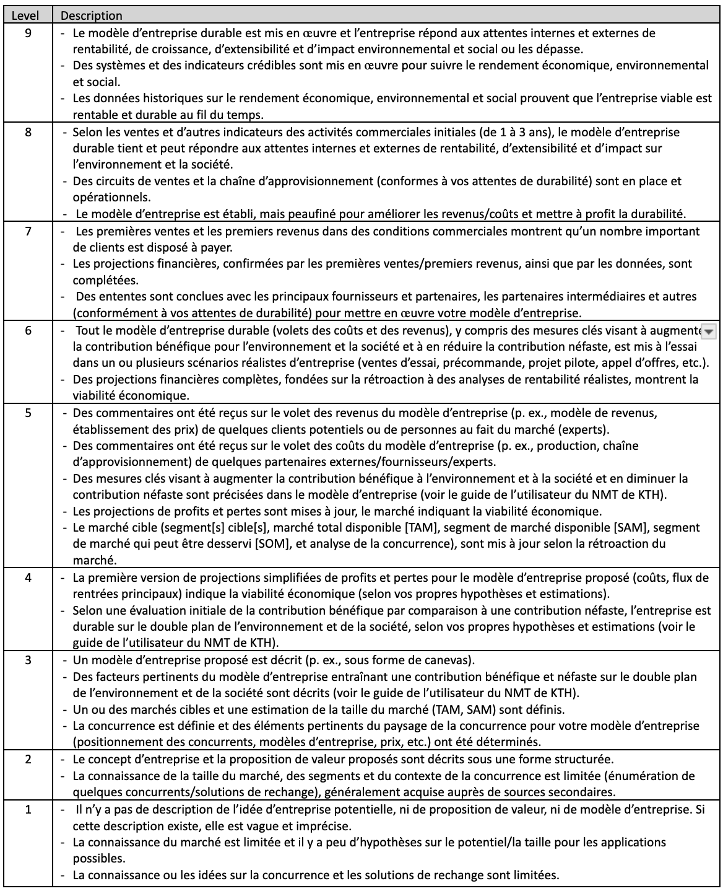
- Indicate which level your startup has COMPLETELY achieved and why;
- Check that you have satisfied all the points mentioned in the description. If you have not achieved all the elements of the level, please default to the lower level;
- Be sure to address each bullet point for the level achieved and support your answers with concrete evidence that you have indeed achieved that level in your journey;
- If you have achieved some of the points listed at higher levels, please mention them.
Business Model Readiness Level – BRL

Slide 11
BUSINESS MODEL READINESS LEVEL – BRL (maximum 4 slides)
What BRL level has been achieved? Type your answer here
What is the customer currently doing to solve the problem? Describe the companies or solutions that are your direct or indirect competitors. How big are these competitors? Why are they market leaders? Include a table showing who your competitors are and how you compare to them on factors that are important to your customers.
Type your answer here

Slide 12
BUSINESS MODEL READINESS LEVEL – BRL (maximum 4 slides)
Describe your sustainable competitive advantage that enables you to position yourself uniquely in the market. Is it a physical product, a digital platform, a service, etc.? Reminder: do not disclose any confidential information.
Type your answer here
What is your revenue model for your solution? If possible, indicate the price you intend to charge and how you arrived at it. Indicate your estimated profit margin.
Type your answer here
What are your main costs in providing the product or service to your customers?
Type your answer here

Slide 13
BUSINESS MODEL READINESS LEVEL – BRL
What is the Total Available Market (TAM), the Serviceable Available Market (SAM), and the Serviceable Obtainable Market (SOM)? Try using a bottom-up approach by describing the number of potential customers and multiplying that number by the price of your solution.
Type your answer here
What are the two or three follow-up markets that could enable you to grow beyond your initial market?
Type your answer here

Slide 14
BUSINESS MODEL READINESS LEVEL – BRL
Present your marketing strategy. How do you plan to build and maintain relationships with your customers? What are the barriers to entry that make it difficult for startups to access the market, and how do you intend to overcome these barriers?
Type your answer here
Tell us about the traction you've seen in the market. Do you have any sales for your solution? Positive customer feedback? Letters of support? Industrial partners?
Type your answer here

Slide 15
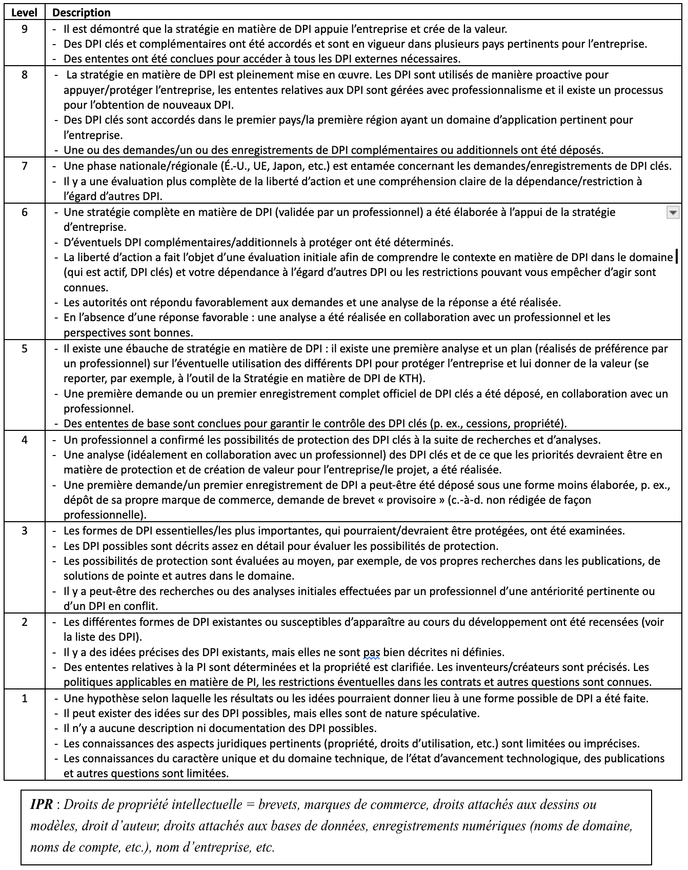
- Indicate which level your startup has COMPLETELY achieved and why;
- Check that you have satisfied all the points mentioned in the description. If you have not achieved all the elements of the level, please default to the lower level;
- Be sure to address each bullet point for the level achieved and support your answers with concrete evidence that you have indeed achieved that level in your journey;
If you have achieved some of the points listed at higher levels, please mention them.
Intellectual Property Readiness Level – IPRL

Slide 16
INTELLECTUAL PROPERTY READINESS LEVEL – IPRL (maximum 3 slides)
What IPRL level has been achieved? Type your answer here
What is the nature of your intellectual property (IP)? Is it know-how, an industrial process, a molecule, a new metal alloy, code, copyright, or something else? Reminder: do not disclose anything confidential. Type your answer here
Who developed the IP? List all the inventors of the IP, as well as their university if the IP was developed in a university setting.
If relevant, what type of protection do you have for this IP?
List all patents, trademarks, industrial designs, or copyrights that you own. Type your answer here

Slide 17
INTELLECTUAL PROPERTY READINESS LEVEL – IPRL
If you do not have protection for your intellectual property, what is your strategy for protecting your IP? What is your time frame for filing applications to obtain this protection?
Type your answer here.
How did you develop this protection strategy? How did you decide which elements were most important to protect? Did you work with lawyers, patent agents, members of a technology transfer office, or other experts? Was a prior art search conducted?
Type your answer here

Slide 18
INTELLECTUAL PROPERTY READINESS LEVEL – IPRL
Was the IP developed using university resources (access to laboratories, doctoral salaries, etc.)? Type your answer here (Yes/No)
If yes, answer the following:
Has a declaration of invention been filed with your institution for this IP? If so, please indicate the name of the institution and the reference number assigned by your institution or by Axelys.
Does your company own the right to use this IP? If so, describe the type of right you hold (licence, assignment, etc.) and the main terms of the agreement (exclusive license, geography, etc.)
If you do not own the right to use this IP, please indicate the status of your discussions with your technology transfer office. What is the plan and timeframe for transferring the rights or IP to you? Type your answer here
If no, answer the following:
Explain how you developed your intellectual property. What resources did you use? Did you develop this IP with other inventors or organizations? What type of agreement did you sign to ensure that the IP belongs to you?
Type your answer here

Slide 19
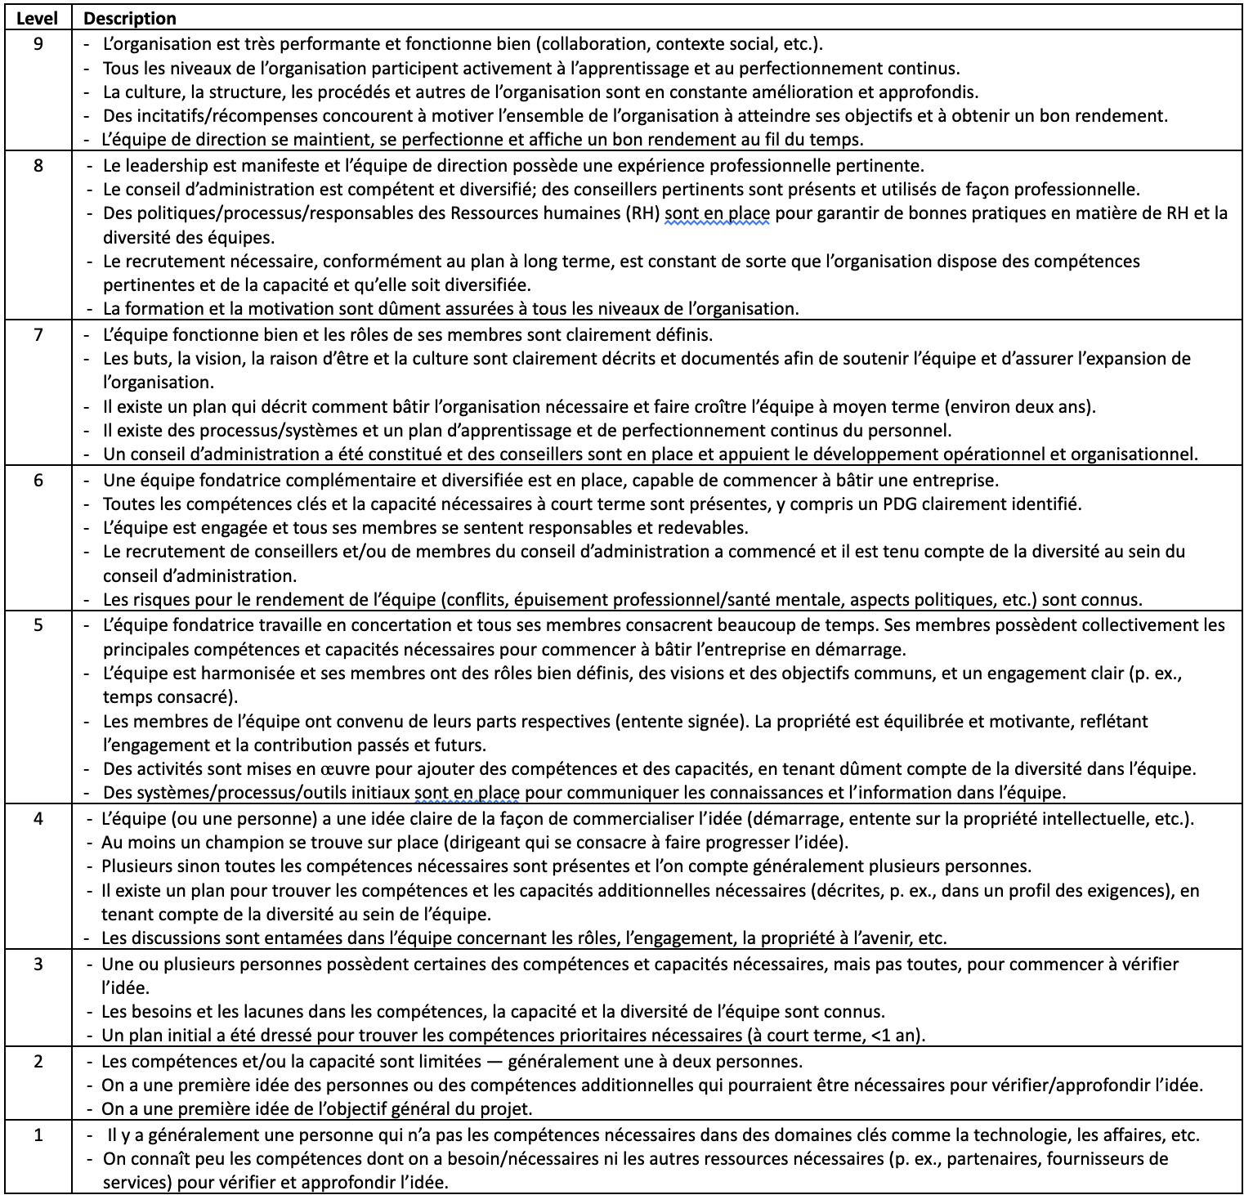
- Indicate which level your startup has COMPLETELY achieved and why;
- Check that you have satisfied all the points mentioned in the description. If you have not achieved all the elements of the level, please default to the lower level.
- Be sure to address each bullet point for the level achieved and support your answers with concrete evidence that you have indeed achieved that level in your journey.
- If you have achieved some of the points listed at higher levels, please mention them.
Team Readiness Level – TMRL

Slide 20
TEAM READINESS LEVEL – TMRL (maximum 3 slides)
What TMRL level has been achieved? Type your answer here
Who are the co-founders and key members of the team? Describe their roles, profiles, and past experiences. Highlight the person applying to CESI, clearly indicating their current role and the anticipated evolution of their role (if relevant).
Type your answer here

Slide 21
TEAM READINESS LEVEL – TMRL
What is the current equity split? Are any changes planned in the short term (within 12 months)? Do you have a shareholders’ agreement?
Type your answer here
What is your vision for the team's development over the next two years? Are there any key people missing from your team? If so, how do you plan to find them? If you believe that no key people are missing, explain why.
Type your answer here

Slide 22
TEAM READINESS LEVEL – TMRL
Who are your main mentors? What is their role and contribution? If you have a board of directors, you can list the members here.
Type your answer here
Have you taken any entrepreneurial training or participated in any incubation or acceleration programs? List all relevant training or programs.
Type your answer here
If applicable, describe your current relationship with your supervisor in relation to the project. How are they specifically involved in the project (overall contribution, hours per week, other)?
Type your answer here

Slide 23
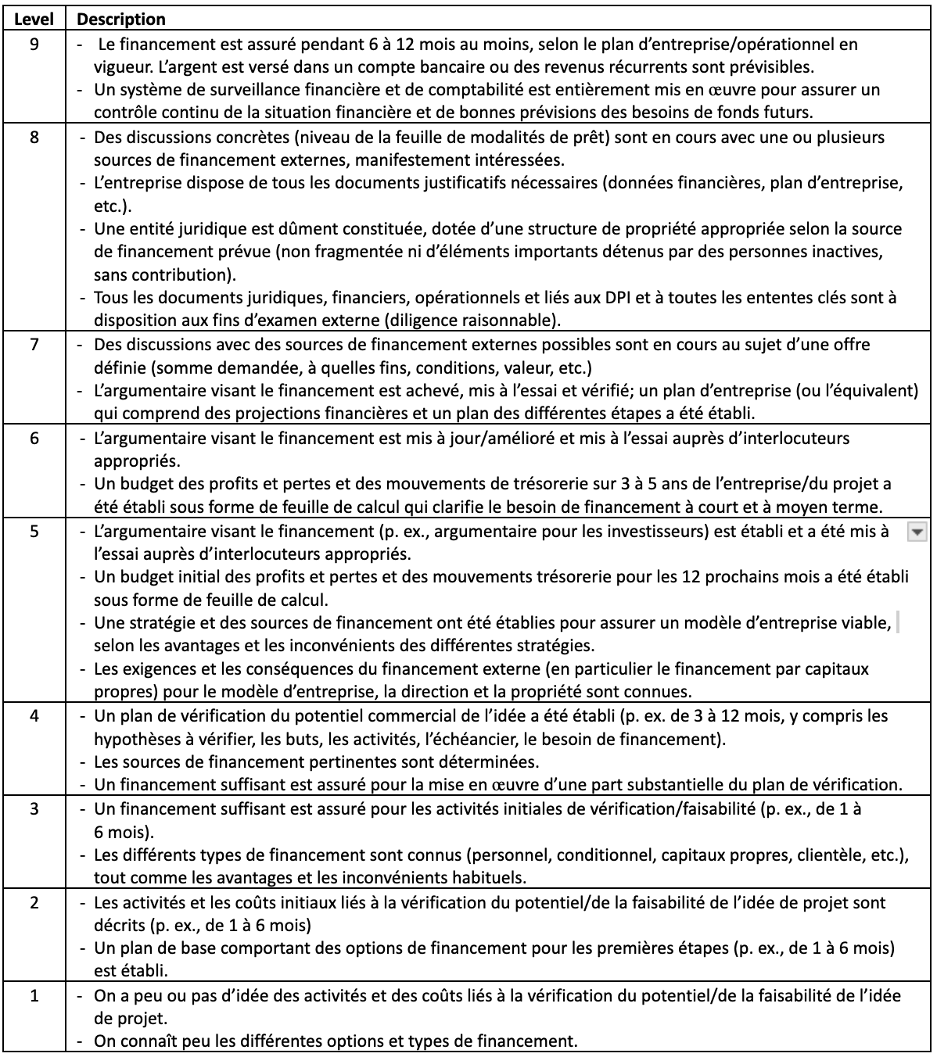
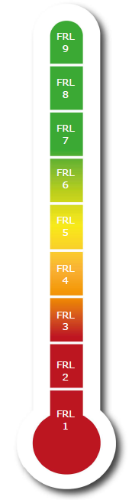
- Indicate which level your startup has COMPLETELY achieved and why;
- Check that you have satisfied all the points mentioned in the description. If you have not achieved all the elements of the level, please default to the lower level;
- Be sure to address each bullet point for the level achieved and support your answers with concrete evidence that you have indeed achieved that level in your journey;
- If you have achieved some of the points listed at higher levels, please mention them.
To be eligible, you must have raised $125,000 or less in dilutive funding (investment in exchange for shares in the company, SAFE, KISS, convertible debentures, etc.) This amount includes any funding from founders, friends, family, angel investors or investment funds. However, it excludes other types of funding such as loans, sales, grants, and subsidies.
Funding Readiness Level – FRL
Niveau admissible
2-8

Slide 24
FUNDING READINESS LEVEL – FRL (maximum 1 slide)
What FRL level has been achieved? Type your answer here
How much money have you raised so far in the following categories?
Dilutive funding (SAFE, KISS, convertible debentures, funding rounds, etc.) Include money invested by founders, family and friends, as well as any other investors or investment fund
Loans, grants or subsidies paid to the company (not to the research lab)
Sales
Total
With the cash currently in the startup, how many months of runway do you have? Type your answer here
What is your envisaged funding trajectory for the next 2-3 years? In other words, what are the major milestones to be completed and how much funding would you need for this? Have you had conversations with investors to discuss your funding plan? If so, what milestones did they ask you to achieve before they would consider investing?
Type your answer here

Slide 25
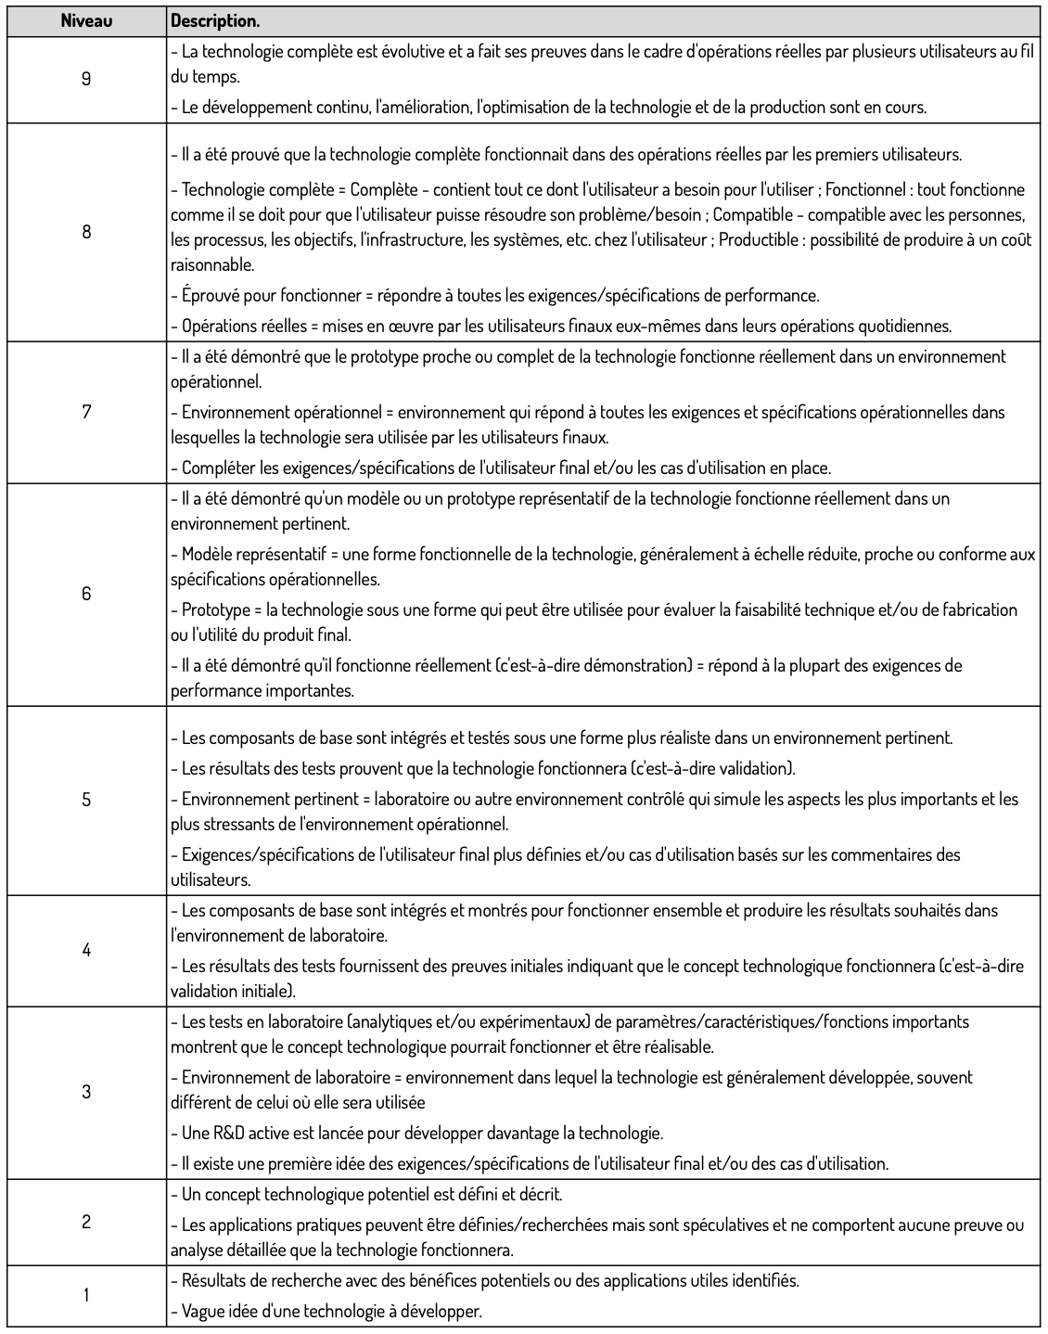
- Indicate which level your startup has COMPLETELY achieved and why;
- Check that you have satisfied all the points mentioned in the description. If you have not achieved all the elements of the level, please default to the lower level;
- Be sure to address each bullet point for the level achieved and support your answers with concrete evidence that you have indeed achieved that level in your journey;
- If you have achieved some of the points listed at higher levels, please mention them.
Only complete this section if your solution can be described in terms of technological maturity level. Otherwise, complete the section on social readiness level.
Technology Readiness Level – TRL

Slide 26
TECHNOLOGY READINESS LEVEL - TRL (maximum 2 slides)
What TRL level has been achieved? Type your answer here
Describe the technical maturity level of your solution. What technological or scientific milestones have you achieved and why is this relevant? If you have a prototype, please include a photo.
Type your answer here

Slide 27
TECHNOLOGY READINESS LEVEL - TRL
Describe the development plan for the solution. What are the scientific uncertainties associated with developing the solution, and what will you do to mitigate these uncertainties? What is your schedule for maturing your technology to a commercial level? You may include a timeline if relevant.
Type your answer here
Describe the regulatory path you will need to take to commercialize your solution. Describe the steps in the regulatory path that you have already completed.
Type your answer here

Slide 28
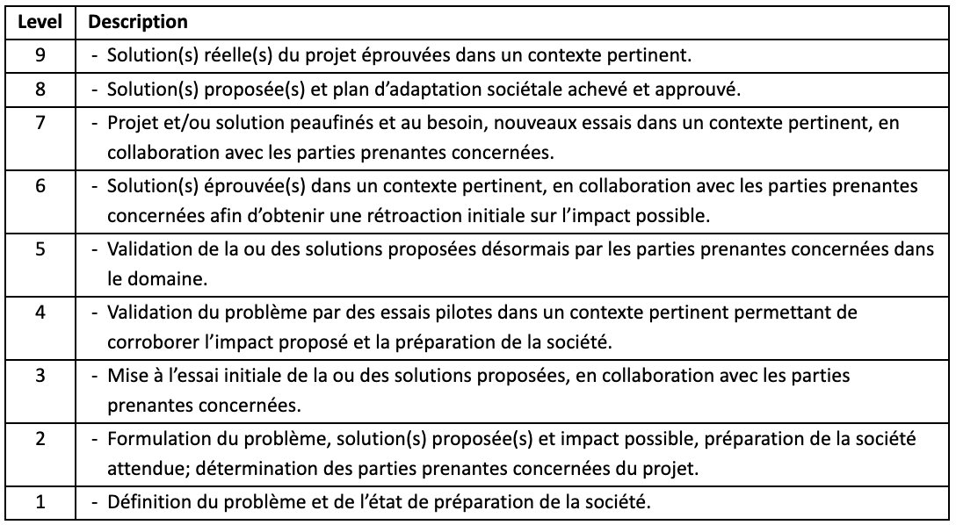
- Indicate which level your startup has COMPLETELY achieved and why;
- Check that you have satisfied all the points mentioned in the description. If you have not achieved all the elements of the level, please default to the lower level;
- Be sure to address each bullet point for the level achieved and support your answers with concrete evidence that you have indeed achieved that level in your journey;
- If you have achieved some of the points listed at higher levels, please mention them.
Only complete this section if you did not complete the section on technology readiness level.
Social Readiness Level – SRL

Slide 29
SOCIAL READINESS LEVEL – SRL (maximum 2 slides)
What SRL level has been achieved? Type your answer here
Describe the level of progress towards implementing your solution. What steps have you taken to engage stakeholders and validate the potential impact of your approach? If you have photos illustrating your solution, please include them.
Type your answer here

Slide 30
SOCIAL READINESS LEVEL – SRL (maximum 2 slides)
What are the uncertainties associated with the development and deployment of your solution, and what will you do to mitigate these uncertainties? Describe your plan and timeline for deploying your solution in a user community and measuring its impact. You may include a timeline if relevant.
Type your answer here
What success criteria will you monitor to determine whether your solution has achieved the desired impact?
Type your answer here

Slide 31
Project impact

Slide 32
Project impact (maximum 1 slide)
Describe how the project has a potential impact on society, the economy and the environment. Highlight your positive externalities.
Type your answer here
What are your negative externalities? How are you mitigating them?
Type your answer here

Slide 33
Anticipated benefits

Slide 34
Potential impact of CESI funding and support (maximum 2 slides)
What is the potential impact of CESI funding and support for you?
Type your answer here
As you transition from research to entrepreneurship, what personal skills do you want to develop over the next 18 months to fill the gaps in your current skill set?
Type your answer here

Slide 35
Potential impact of CESI funding and support
What is the potential impact of CESI funding and support for your startup? What significant milestones will the CESI award enable you to achieve, and how does this tie in with the major growth stages ahead for your startup?
Type your answer here
What are your personal expectations and those for your startup in terms of support from the CESI team?
Type your answer here

Slide 36
The need for a host university for the creation or development of the startup (maximum 1 slide)
Do you need a host university to advance your entrepreneurial project? Explain why. Provide us with any other important information related to the need for linkage with a university.
Please note that you are not expected to have taken steps to find a host university before applying to CESI.
Type your answer here

Slide 37
Bibliography

Slide 38
References: bibliography and information sources
Back up your project with science by listing key publications that support the information provided in your presentation

